Slide 2

Student’s engagement detection in online classes
Phan Minh Hòa - 20225495

Slide 3
Content
Introduction
Literature Review
Methodology
Experimental Results
Conclusions

Slide 4
1. Introduction
Problem Statement
Online and hybrid classes are common.
Tiles of webcam cannot convey the signal teachers needed to read the room, hence, adapts the lesson.
The Task
Task: Detect students’ engagement level
Input: 10s clips from students’ webcams
Output: 4 classes (E0 -> E3)

Slide 5
1. Introduction
Related Works
Black box end-to-end.
Extract facial-behavior features first.
Research Gaps
Facial features are always flatten.
Only accuracy is used for evaluation.
Cross dataset generalization evaluation is limited.

Slide 6
1. Introduction
Contributions
New hybrid architecture.
New private dataset manually labeled from a SOICT online class.
Evaluation protocol with multiple metrics.

Slide 7
2. Background Knowledge
Features
OpenFace features:
709 facial features per frame.
I3D features:
1024 features per clip
Trained on Kinetics-400
Architecture
MLP (Multilayer Perceptron)
TCN (Temporal Convolutional Network)
LSTM (Long Short-Term Memory)
Transformer

Slide 8
2. Background Knowledge
Evaluation Metrics
Accuracy
Macro-accuracy
Mean absolute error (MAE)
Macro-MAE
Cohen’s Kappa
Quadratic-weighted kappa (QWK)
Statistical Measures
Spearman’s rank correlation

Slide 9
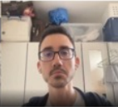

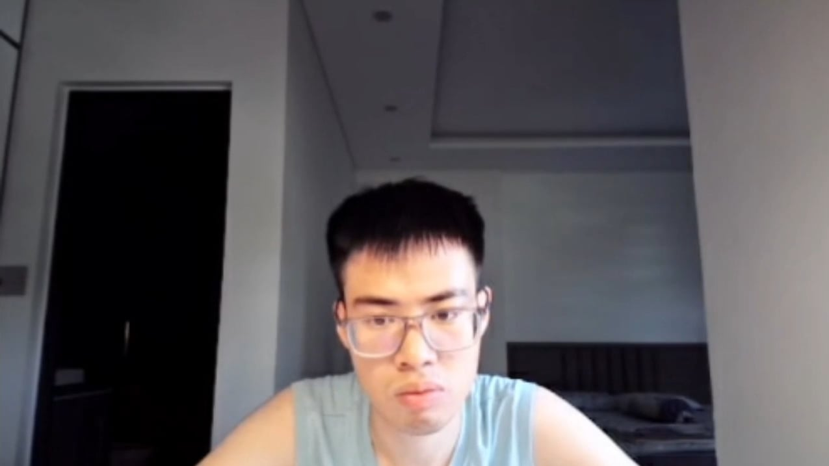
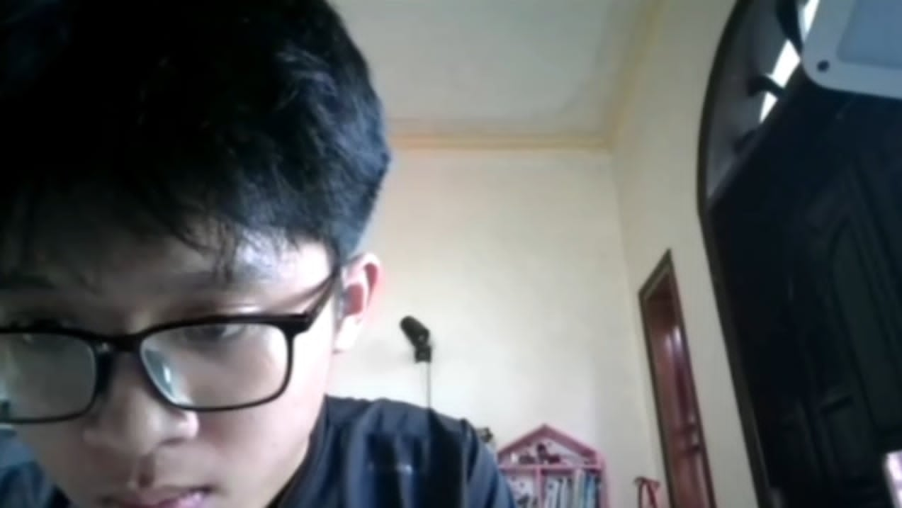
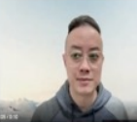
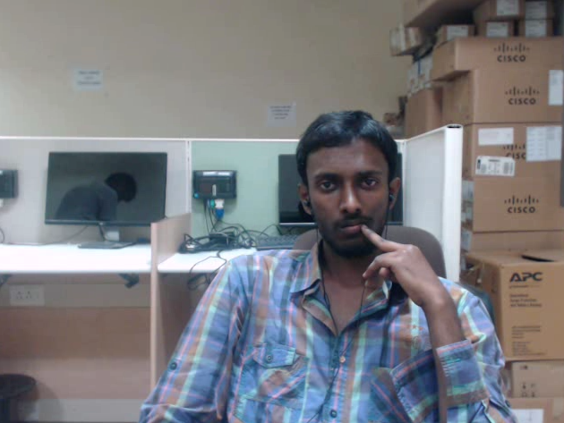
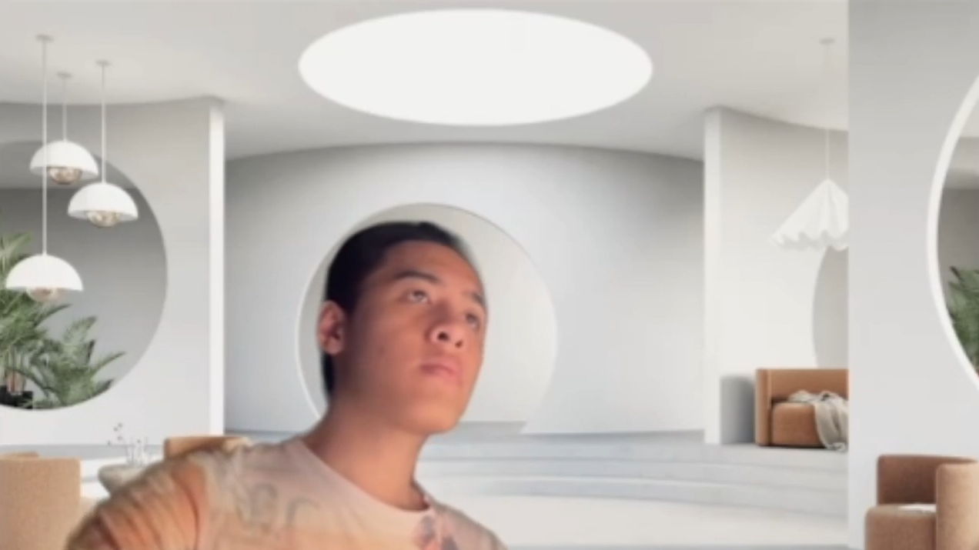
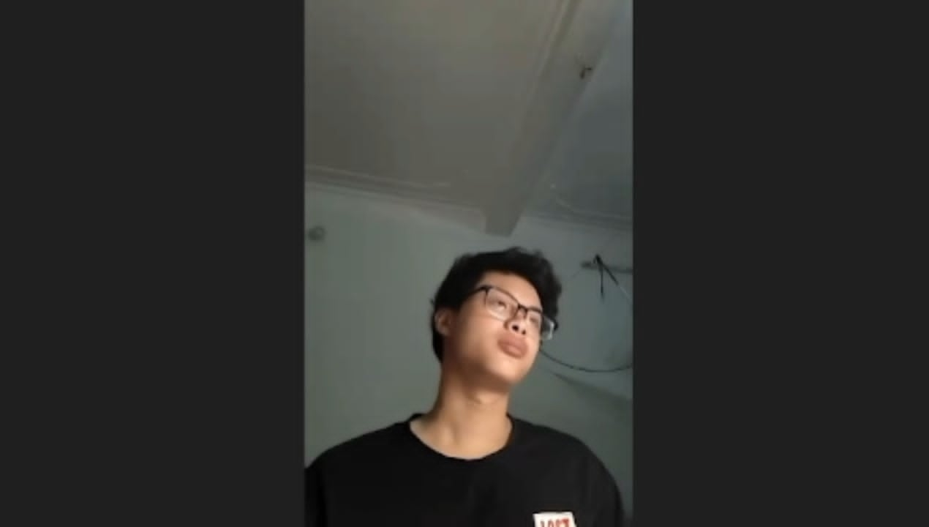
3. Methodology
Datasets
Class | CMOSE | DAiSEE | Private
E3 | 9.6% | 43.8% | 30.6%
E2 | 69.4% | 50.3% | 58.2%
E1 | 18.1% | 5.1% | 8.5%
E0 | 2.8% | 0.7% | 2.7%
CMOSE
DAiSEE
Private

Slide 10
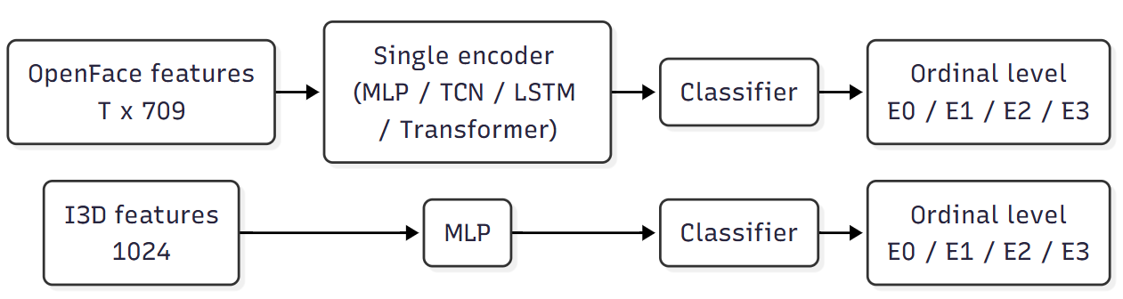
3. Methodology
Baseline Architectures
5 single-encoder baselines:
4 over OpenFace (MLP, TCN, LSTM, Transformer)
1 over I3D (MLP)

Slide 11
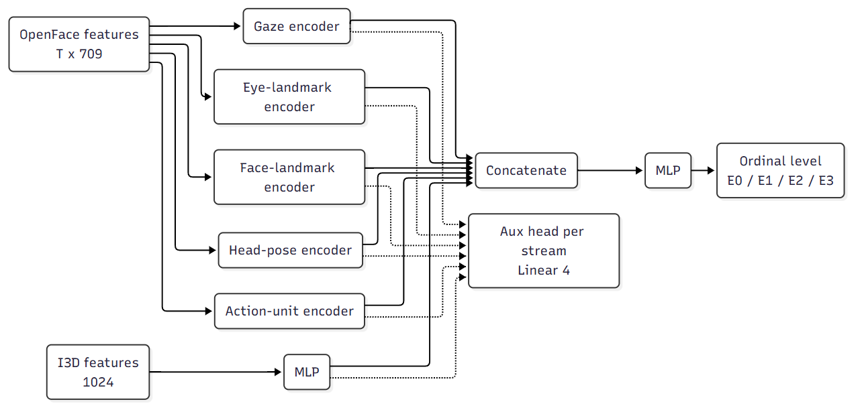
3. Methodology
Proposed Hybrid Architecture
5 feature groups
Each group have its own encoder
Optional I3D motion
Each stream have auxiliary head

Slide 12
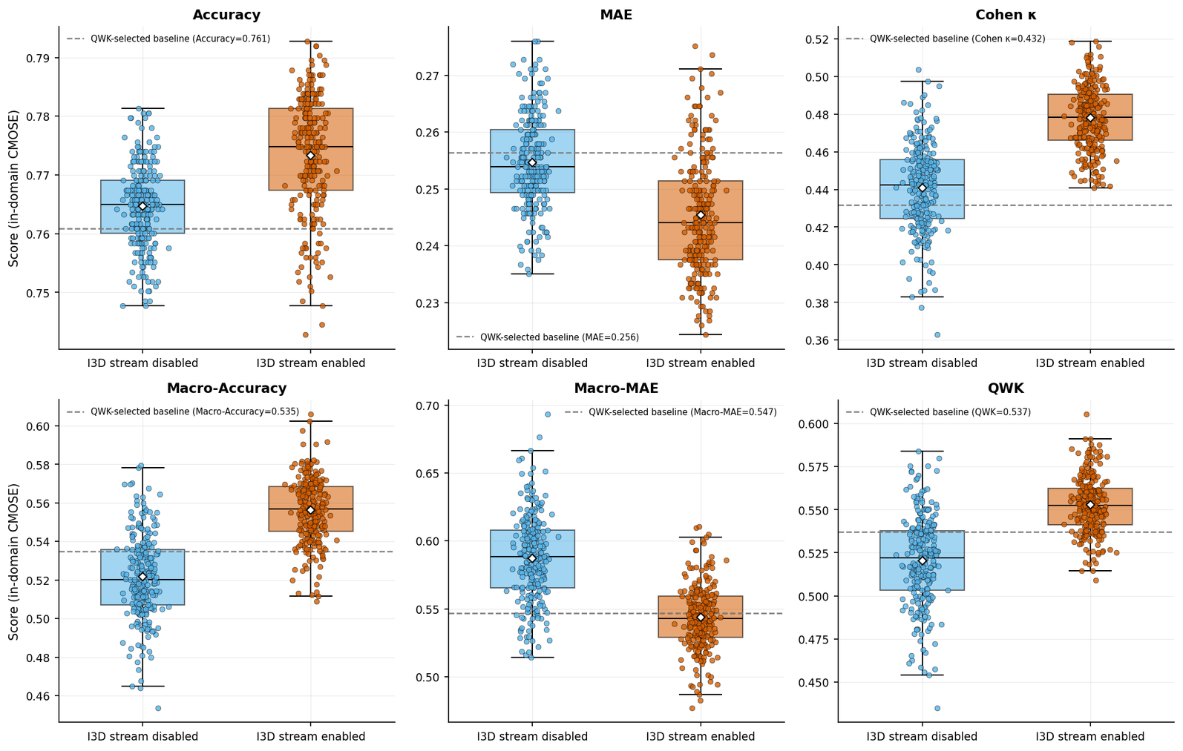
4. Experimental Results
CMOSE In-Domain Result
Best proposed model outperform best baseline.
I3D stream enabled shows in-domain improvement.

Slide 13
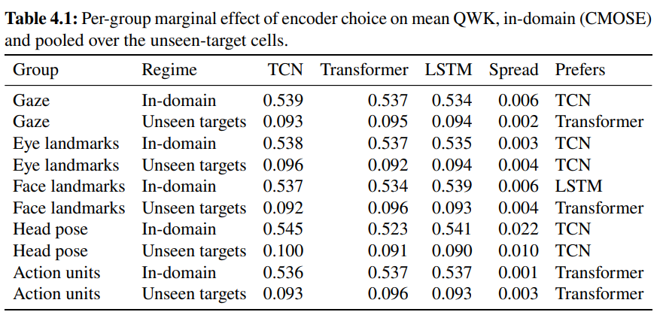
4. Experimental Results
CMOSE In-Domain Result
Feature groups don’t show clear preference.
Head pose lightly prefers TCN.

Slide 14
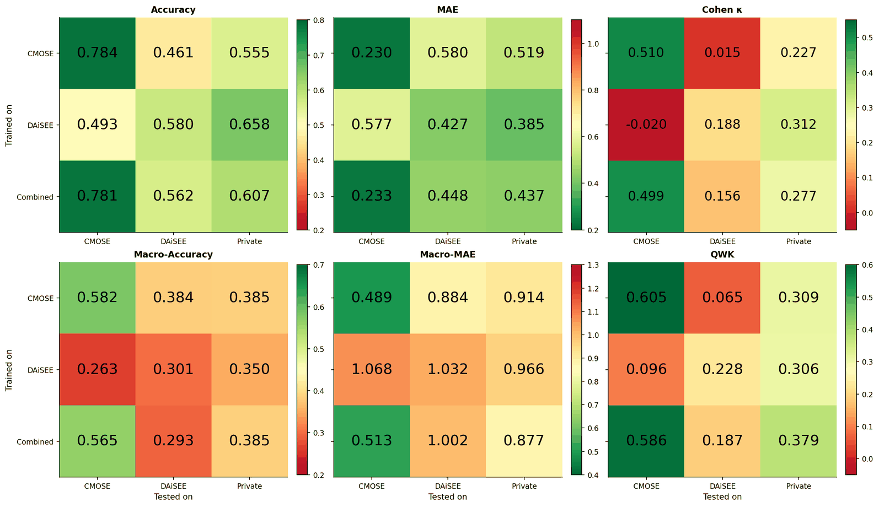
4. Experimental Results
Cross-Dataset Result
QWK value collapses off-diagonal while accuracy is still good.

Slide 15
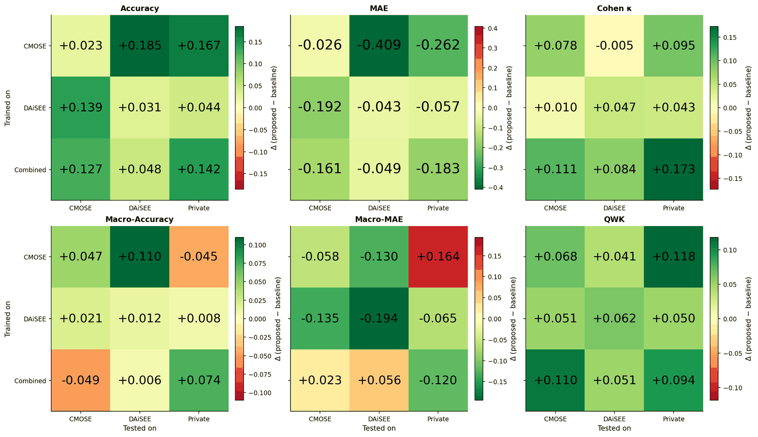
4. Experimental Results
Cross-Dataset Result
Best proposed model outperform best baseline cross dataset .

Slide 16
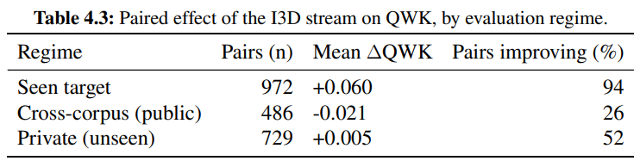
4. Experimental Results
Cross-Dataset Result
Improvement from I3D stream is not significant cross-dataset.

Slide 17
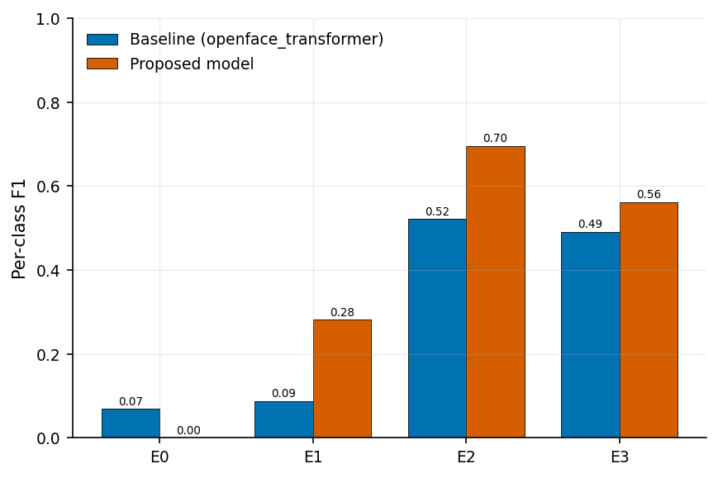
4. Experimental Results
Private Dataset Result
F1 score of the rare E0 class drop to zero.
F1 score of other classes are lifted.

Slide 18
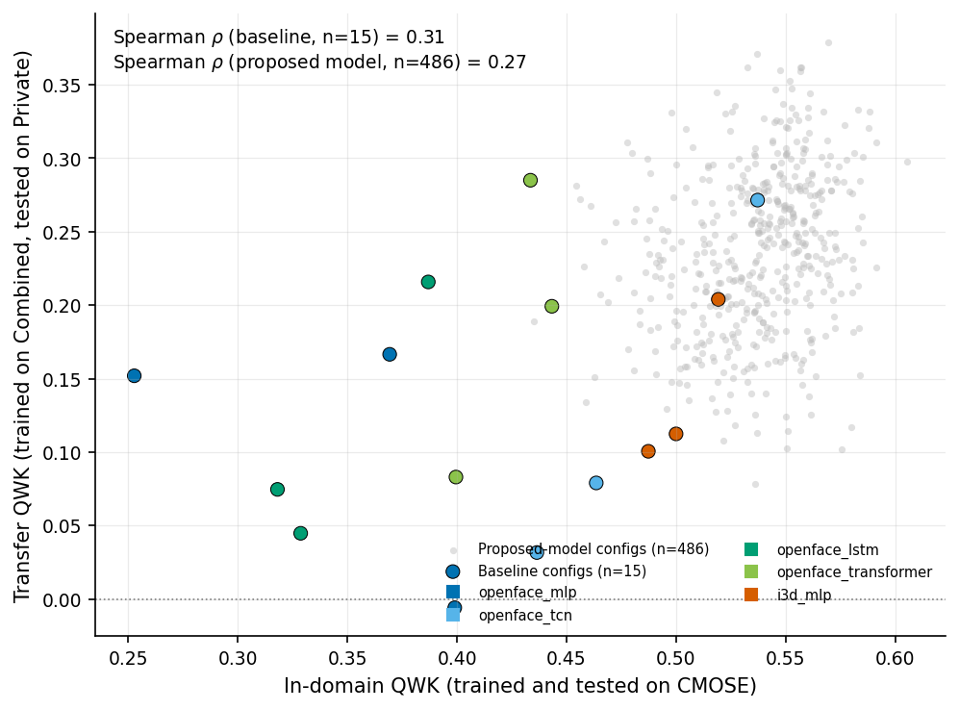
4. Experimental Results
Private Dataset Result
In-domain performance cannot predict transferability.

Slide 19
5. Conclusions
Summary
Architecture:
New hybrid architecture
+0.068 QWK in-domain
+ 0.094 QWK on private set
Private dataset:
366 clips.
Manually labeled.
Generalization:
Low QWK exposes low transferability

Slide 20
5. Conclusions
Limitations
Private dataset
Small
Single annotator
Inability to discriminate class E0
Future Work
Private dataset
Larger dataset
Multi-annotator with reported inter-annotator agreement
Domain Adaptation for Private Dataset
Learned group encoders

Slide 21
THANK YOU !

Slide 22
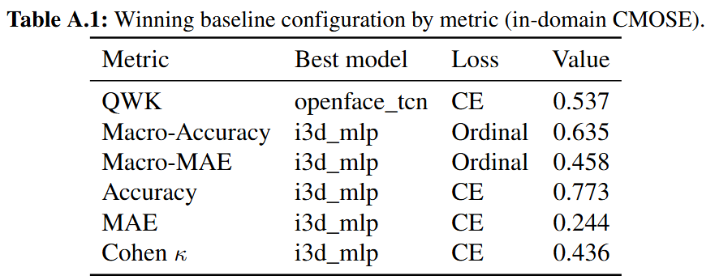
Backup Slides

Slide 23
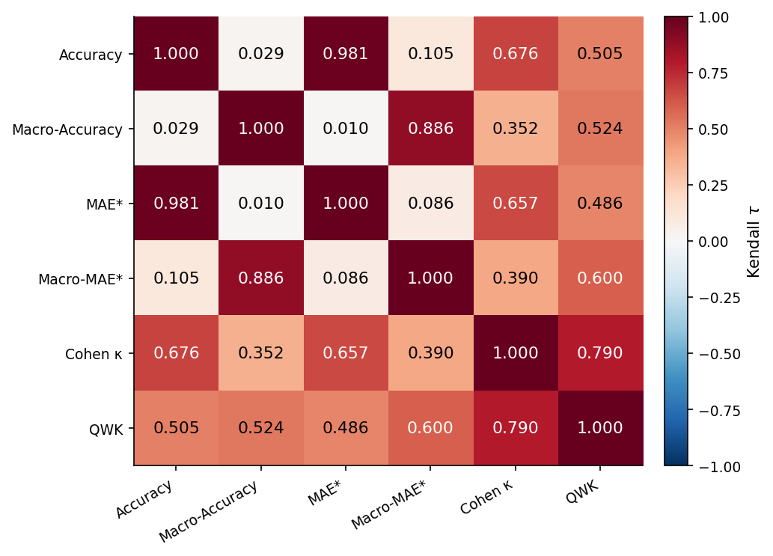
Backup Slides

Slide 24
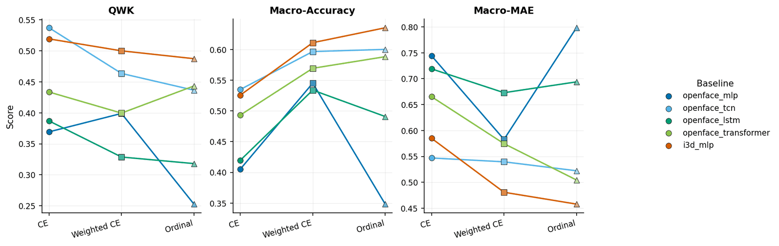
Backup Slides

Slide 25
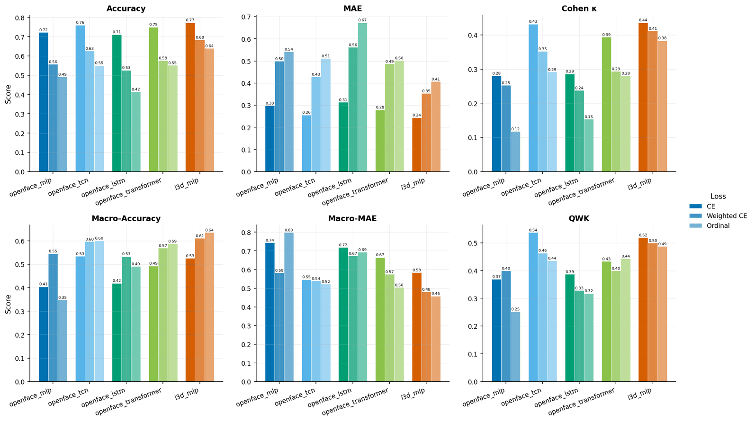
Backup Slides

Slide 26
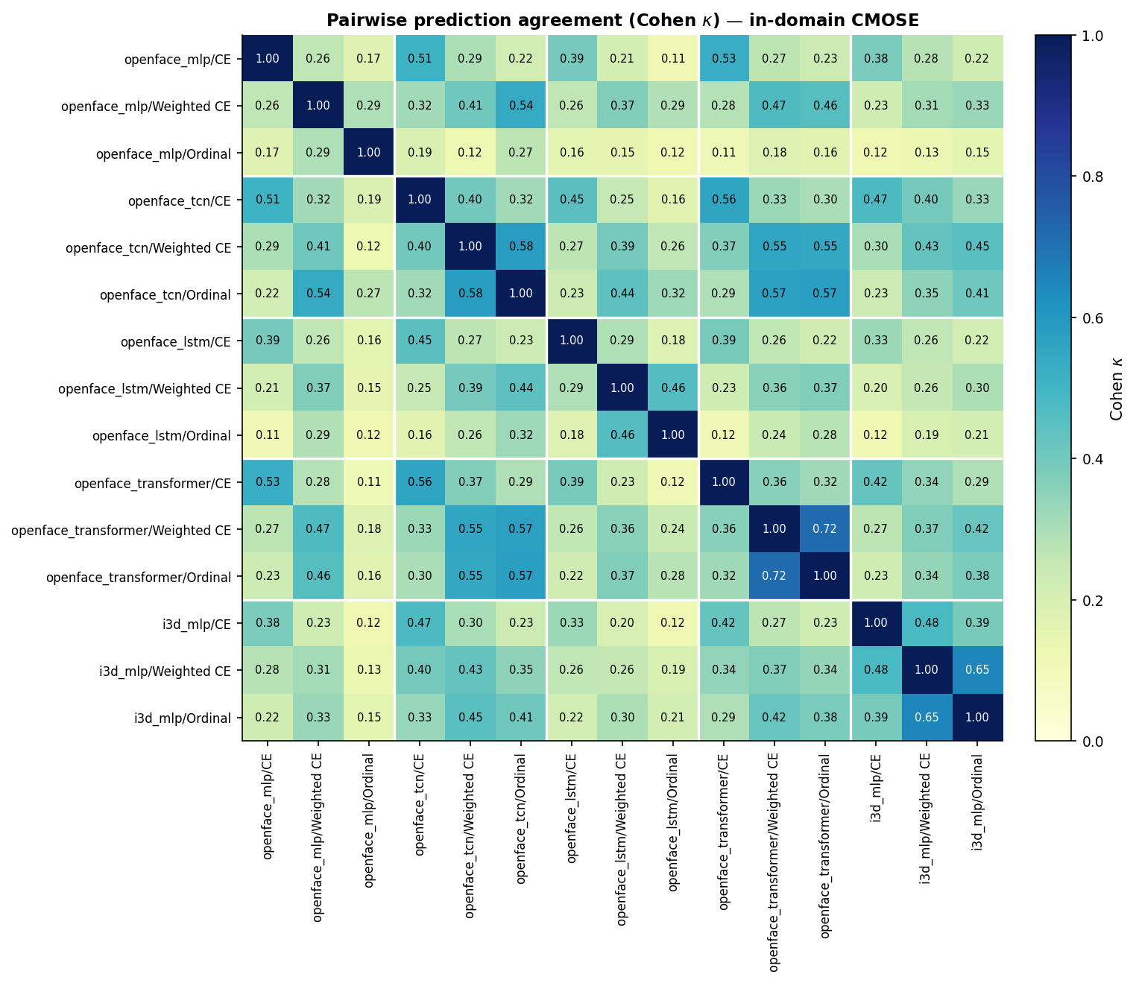
Backup Slides

Slide 27
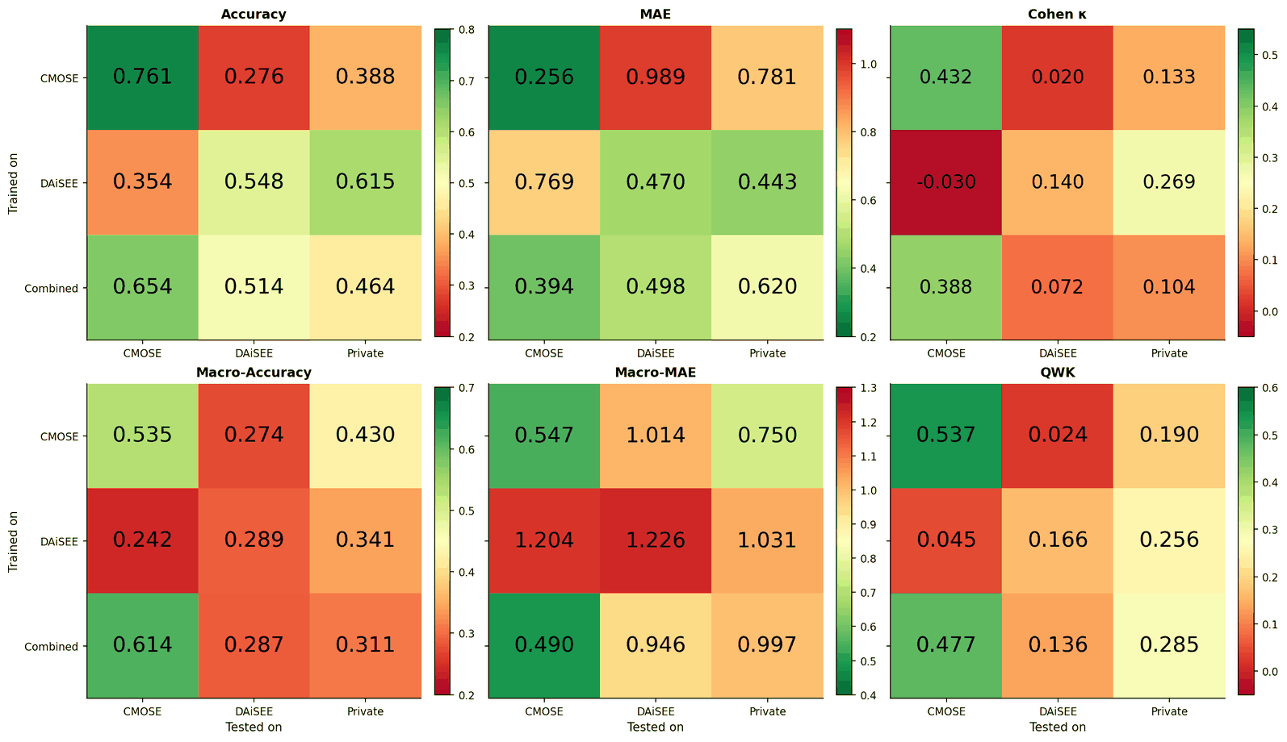
Backup Slides

